Slide 1
CS 35L, Fall 2017
Zhaowei Tan

Slide 2
Lectures
Boelter 3760
Tuesdays/Thursdays 12:00 pm - 2:00 pm
Syllabus: http://web.cs.ucla.edu/classes/fall17/cs35L/syllabus.html
We will cover:
System basics (Unix, bash, security)
Programming basics (languages, debugging)
A lot to learn!

Slide 3
Instructors
Professor Paul Eggert
Office hour:
Mondays 2-4 PM, Thursdays 10-11 AM
Zhaowei Tan
Second year PhD, research in system & networks
Office hours:
Boelter 2432, Mondays 9:00 – 11:00 AM
Email: tan@cs.ucla.edu

Slide 4
Websites
Course website: Assignments, useful links http://web.cs.ucla.edu/classes/fall17/cs35L/index.html
Piazza: For discussion
CCLE page: News and assignment submission

Slide 5
Grading and Assignments
http://web.cs.ucla.edu/classes/fall17/cs35L/grading.html
50% homework, 50% open-book final
No cheating!
http://web.cs.ucla.edu/classes/fall17/cs35L/assign.html
Lab + Homework
Be aware of the due (23:55 on the specified date)
Pay attention to the changes (in the news)
Notes:
Don’t copy others. Do not directly ask students from last quarter. Sadly true that this happened before.

Slide 6
Special Notes
Assignment 10: Research news reading
Includes an in-class presentation
Might start from week 4/5
Coordinate in week 3
BeagleBone Green Wireless Development Board
Used for a few later assignments
Basic version or an upgraded version
Notes:
Great to have a small course! Everybody has a chance to present
Rest assure: the news is easy, not very research-y

Slide 7
Why CS 35L
Get familiar with commonly-used environment, languages, and tools
Comfortable with the software construction!
Useful in academia
Fundamental to upper-division courses
Useful in industry
The very basic for a programmer
Useful in various areas
Notes:
Hard to summarize what you can learn from 35L

Slide 8
Introduction, Files, and Editing
Zhaowei Tan
Sep. 28

Slide 9
What is Operating System (OS)
OS: A program that acts as an intermediary between a user of a computer and the computer hardware
Operating system goals
Execute user programs and make solving user problems easier
Make the computer system convenient to use
Use the computer hardware in an efficient manner
Notes:
Provide a lot of built in functions
Provide interfaces
You do not want to deal with hardware

Slide 10
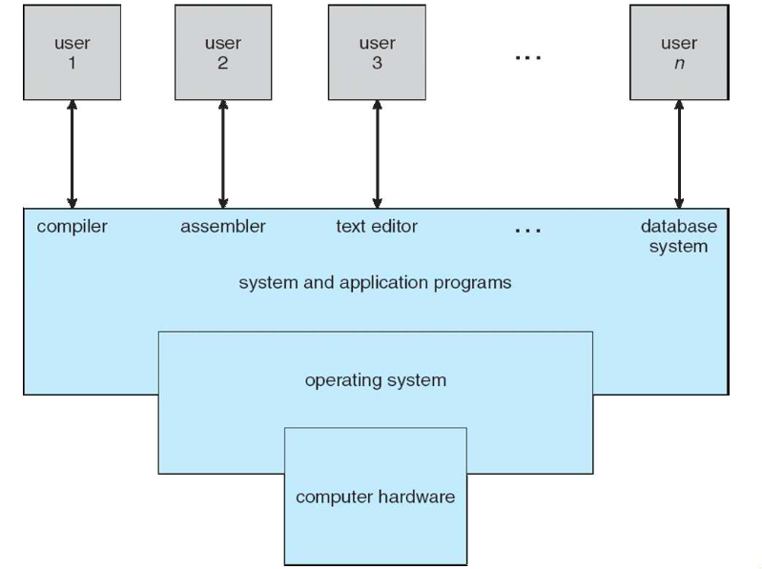
[Operating System Concepts, Seventh Edition]
Notes:
OS translates the programs differently, that’s why a MAC program cannot run on windows.
You might ask, what about a language, a simple C script can be run on both windows and linux

Slide 11
Multiuser and Multiprocess
Multiuser
Multiple users accessing a single system
Multiprocess (multitasking)
Execute multiple tasks concurrently
Unix-like OS are multiuser and multiprocess
Realized by time-sharing
OS takes care of switching, scheduling, etc.
Notes:
Not necessary in the exact same time. E.g. multicore. Even that, it leverages time sharing

Slide 12
Birth of Unix and C
1969: The Birth of Unix
Ken Thompson in Bell Lab
Old OS Overhead High → A more effective OS
1973: The Birth of C
Unix is a success, but hard to port
Dennis Ritchie invent C and re-write Unix
Notes:
They want to try another hardware, but at the time all written in assembly language

Slide 13
Unix Development
1977: Berkeley Software Distribution
Bill Joy in University of California, Berkeley
Add-ons, not simply an OS
Unix becomes commercial product in 1979
AT&T sued UCB in early 1990s
Notes:
They want to try another hardware, but at the time all written in assembly language

Slide 14
A Road to Open Source
1983: Foundation of GNU project (Not Unix!)
Richard Mathew Stallman at MIT
Goal: free Unix-like system
Contribution: (OS + a collection of software)
GNU C Compiler (GCC)
Emacs (Professor Eggert is a contributor!)
1987: Minix: Unix-like OS
Compatible with Unix, source code available but still restricted
Notes:
GNU’s design is actually like Unix, but
Unix programs could run on Minix
But slow!

Slide 15
Here Comes Linux
Linus Torvalds: Junior CS student at University of Helsinki
Minix on Intel i386 → Too slow
He referred the source code of Minix, and developed Linux using bash and gcc
Linux: Last pieces of GNU project
1991 – now: Linux distributions
Notes:
Android, ubuntu

Slide 16
GUI and CLI
Graphical User Interface (GUI) is user-friendly desktop interface
E.g., X, Wayland, GNOME
Icons represent files, programs, actions, etc.
Mouse over objects triggers actions
Command Line Interface (CLI) allows direct command entry
E.g., Bash, xterm
Fetches a command from user and executes it
Sometimes commands built-in, sometimes just names of programs

Slide 17
Unix File
Everything is a file
Regular file
Directory
Symbolic file (ln –s)
Device file (cd /dev)
Each file has permission
Permission Groups: Owner, group, all users
Permission Types: Read, write, execute

Slide 18
Environment Path
PATH: environmental variable in Unix-like OS
After user types a command, shell searches the directories indicated in the PATH variable, checking if any program matches the name
echo $PATH to see the directories in path, separated by semicolons
You can add or remove directories to/from PATH

Slide 19
Appendix
How to read ls –l:
1: Type (directory, symbolic, regular)
2-4: Owner’s permission (Read, write, execute)
5-7: Owner group’s permission
8-10: Everyone’s permission
How to use chmod xxx filename:
First digit: owner, second: group, third: everyone
4: read, 2: write, 1: execute
Example: grant group read/write, no excute: 4+2=6 chmod x6x filename
Useful commands: find, whereis, grep, ssh, scp

